Slide 1
GROUP NO-7
Presented by
Sreerag R Nandan-JEC17CS099
Sangeetha P-JEC17CS087
Nova Dileep-JEC17CS0
San Jose-JEC17CS089

Slide 2

ONLINE PAPER EVALUATION SYSTEM

Slide 3
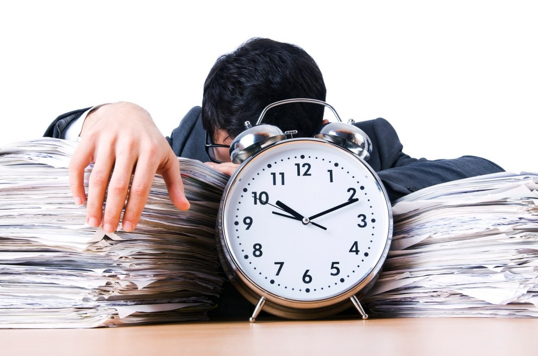
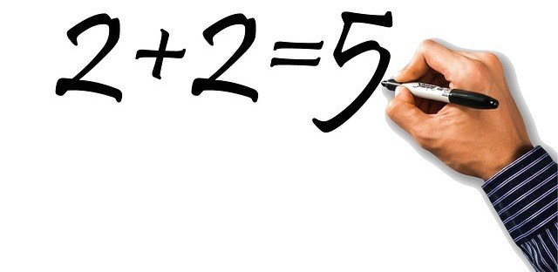



WHY THIS?
Notes:
Main objective
Avoid mistakes from the side of evaluator
It reduce time taken to correct the paper
Impartial evaluation
Reduces burden of teachers and encourage them to do more productive work
WHY THIS?
Current evaluation process leaves the future of the student at the mercy of the teachers.
There are several mistakes that occur on the checking department's side like totaling error, marking mistake and sometimes there can be partiality in evaluation of marks.
The practice of current evaluation system is used widely across the world and students across all the areas have been facing the drawbacks of this current evaluation system.

Slide 4






WHAT?
Notes:
Basic Idea
Scanning student’s paper and answer key
Thus converting it into digital document
Then student’s answer is Compared with answer Key
And Awarding marks
Then we are notifying his mistake to him as We are not considering this system only for evaluation, student’s will get a chance to improve their performance
WHAT
The first and the most important step is to scan and upload the student’s answer paper into the system.
Secondly,the answer written by the student is compared with the answer key and the marks are awarded accordingly.
This is done by handwriting recognition from .pdf or.jpeg or any other format.
Finally one extra page is appended at the last to notify the student for improvements/suggestions.

Slide 5


HOW?
Notes:
The basic technologies that we are planning to use is ML and image processing
By combination of these two technologies we will extract information from the answer sheet and analyse its similarity with the answer in answer key and evolution is carried out ; we hadn’t figured our an exact algorithm we will do It in next stage

Slide 6
MERITS & DEMERITS
One of the major problem with the ecurrent evaluation system is the biasness of the evaluator.
Lack of interest and time urges the evaluator to complete the evaluation within a short period of time.
Apperance of the paper is also a demerit of the existing evaluation system.
Another major issue is the time delay that is involved with current evaluation system.
So the idea of online paper evaluation system overcomes all these demerits.
So the idea of online paper evaluation system overcomes the above mentioned demerits of the existing evaluation system.

Slide 7

FEASIBILITY
Notes:
As we cannot evaluate creative subject with this algothm

